Slide 1

Differences Between Python and Java Characteristics, Use Cases, and Advantages
Alli m.J
DATA SCIENTIST
AUG 2024

Slide 2
Introduction
Overview:
Python and Java are two popular programming languages.
Understanding their differences helps in choosing the right language for a project.
Objective:
Compare key characteristics, use cases, and advantages.

Slide 3
Python Overview
Definition: Python is a high-level, interpreted programming language known for its readability and simplicity.
Creator: Guido van Rossum
First Released: 1991
Key Features:
Easy-to-read syntax
Supports multiple programming paradigms
Large standard library

Slide 4
Java Overview
Definition: Java is a high-level, compiled programming language known for its portability and performance.
Creator: James Gosling
First Released: 1995
Key Features:
Strongly typed language
Runs on the Java Virtual Machine (JVM)
Object-oriented programming

Slide 5
Syntax Comparison
Python Syntax:
Simple and readable:
print("Hello, World!")
Java Syntax:
More verbose:
public class HelloWorld {
public static void main(String[] args) {
System.out.println("Hello, World!");
}
}

Slide 6
TYPING SYSTEMS
Python:
Dynamically typed (no need to declare types)
Example: x = 10 (type inferred)
Java:
Statically typed (types must be declared)
Example: int x = 10;

Slide 7
Performance
Sorting Algorithm: quick sort
Python:
Generally slower due to interpreted nature and dynamic typing.
Java:
Faster due to compilation to bytecode and Just-In-Time (JIT) optimization on the JVM.

Slide 8
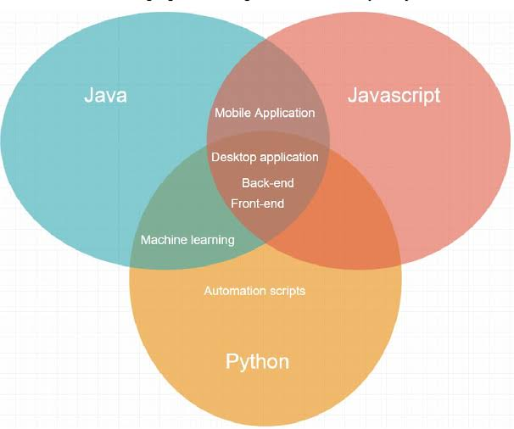
Use Cases
Python:
Web Development (Django, Flask)
Data Science (Pandas, NumPy)
Scripting and Automation
Java:
Enterprise Applications (Spring Framework)
Android App Development
Large-scale Systems

Slide 9
Libraries and Frameworks
python
java
Python:
Libraries: NumPy, Pandas, TensorFlow
Frameworks: Django, Flask
Java:
Libraries: Apache Commons, Guava
Frameworks: Spring, Hibernate

Slide 10
Learning Curve
Python:
Easier for beginners, intuitive and concise syntax.
Java:
Steeper learning curve due to verbosity and complex syntax.

Slide 11
Community and Support
python
java
Python:
Strong community support, extensive documentation, numerous resources.
Java:
Large community, extensive enterprise support, rich set of resources.

Slide 12
Advantages & Disadvantages
python
java
Advantages:
Readability and simplicity
Rapid development
Flexibility
Disadvantages:
Slower execution
Less suitable for mobile applications
Advantages:
Performance and speed
Portability (Write Once, Run Anywhere)
Strong typing
Disadvantages:
Verbose code
More complex syntax

Slide 13
Summary
Recap:
Python is known for its ease of use and flexibility, ideal for rapid development.
Java offers performance and robustness, suited for large-scale and high-performance applications.
Final Thoughts:
Choice depends on project requirements, performance needs, and development speed.

Slide 14
References
Books:
“Python Crash Course” by Eric Matthes
“Effective Java” by Joshua Bloch
Websites:
Python Official Documentation
Java Official Documentation

Slide 15
Thank You
The end

